Slide 1
Acids

Slide 2
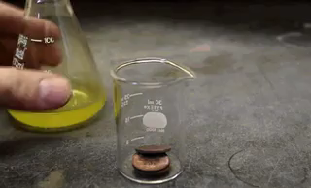
By the end of this lesson you should be able to:
Define an acid.
Explain how acids dissolve.

Slide 3
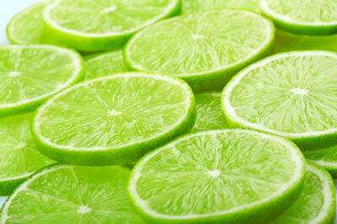
The only purpose of an acid is to react.
They are most often encountered as solutions (called "aqueous"), although sometimes they appear in the form of crystals.
Some examples of acids include vinegar, stomach acid, and citric acid.

Slide 4
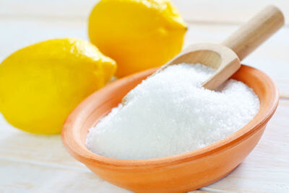
Citric acid is found in citrus fruits, such as oranges and lemons, and is the ingredient that makes these fruits sour.
It is not a very strong acid, but getting lemon juice in a wound hurts, and eating too much citric acid can give you a stomach ache.
The formula of citric acid is C₆​H₈​O₇​.

Slide 5

Vinegar, otherwise known as ethanoic acid, is produced by fermenting ethanol.
The reactive properties of ethanoic acid mean that it is used in many industrial reactions, as well as for household cleaning.
The formula of acetic acid is CH₃​COOH.

Slide 6
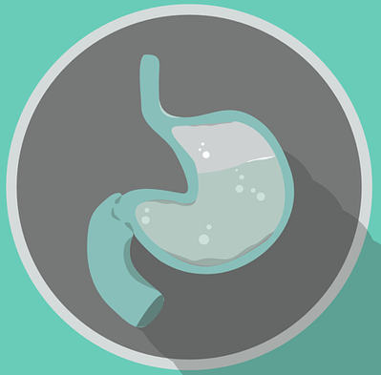
Stomach acid is mostly made up of hydrochloric acid, and is used by our body to break down food.
Hydrochloric acid is one of the strongest acids, and can cause serious burns. It is frequently used industrially to produce chloride-containing substances.
The formula of hydrochloric acid is HCl.

Slide 7

All acids have similar chemical properties.
Most commonly, acids react easily with chemicals such as bases and metals.
They are also corrosive, sour-tasting and conduct electricity.

Slide 8
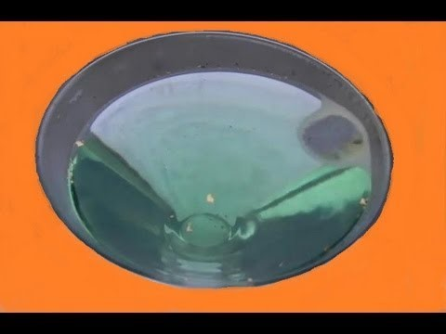

Slide 9
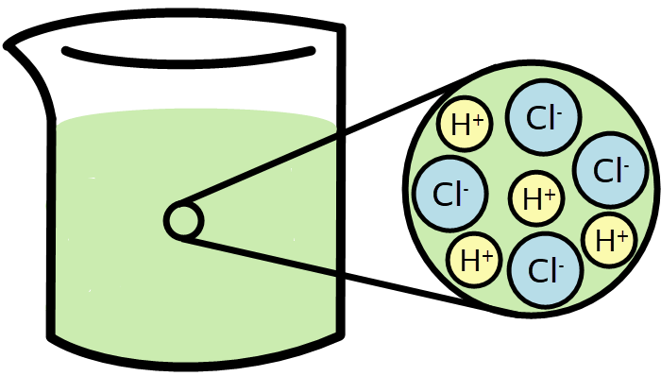
As solids, most acids are crystals, but will quickly dissolve in water to produce an acid solution.
Dissolving separates the acid into ions. A stronger acid, like hydrochloric acid (HCl), dissolves into the reactive ions H+ and Cl−.
Because these ions are so ready to react, they will quickly break down materials they contact, giving the acid its corrosive nature.

Slide 10
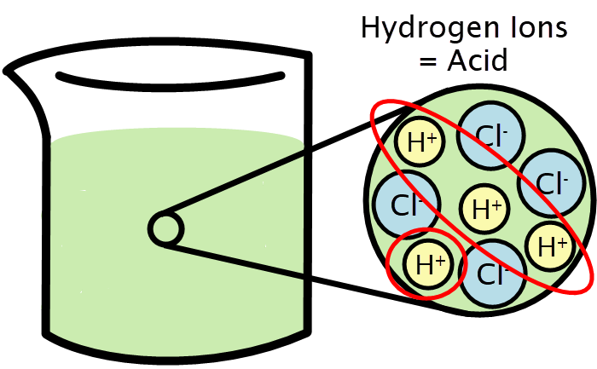
Acids are defined as chemicals that release hydrogen ions when dissolved into a solution.
The hydrogen ion (H⁺) is also known as a proton, because that is all that is left of the hydrogen atom once it loses its only electron.

Slide 11

Equations for the dissolution of an acid can be written as:
Acid → Positive Hydrogen Ion + Negative Ion

Slide 12
For example, vinegar is a mixture of ethanoic acid and water.
Ethanoic acid dissolves in water by the below equation:
Ethanoic Acid | → | Hydrogen Ion | + | Ethanoate Ion
CH_{3​}COOH → H⁺ + CH₃​COO⁻

